Slide 1

CompSci234 Advanced Networks
Project Poster(Version 1)
Under the supervision of Prof. Nalini Venkatasubramanian
Preeti Ahuja UCI ID: 42081780 Pralay Biswas UCI ID:36729034 Santanu Sarma UCI ID:

Slide 2
SensDroid
An Information Exchange Framework for Mobile Sensor Networks using Android phones

Slide 3
Presentation Overview
Goal of the project
Related Work
Mobile Sensors
Use Cases/ Applications
Current Mobile Sensing Systems
Application Architecture
Infrastructure
Milestones achieved
Evaluations
References

Slide 4
Goal of the project
Given the ubiquity of smartphones, SensDroid aims at building a mobile sensor information exchange system.
SensDroid enables a person using an Android phone to remotely activate a sensor in another Android phone, capture the sensor data and display the sensor data of this remotely located phone onto the person’s phone.
For example, consider the requirement of determining the room temperature of a room present in some floor of a multi-storeyed building, from another room which is in some other floor of the same building. In this case, SensDroid would enable remote activation of temperature sensor of the mobile device present in one room, which then communicates this information back to the mobile device present in the other room.

Slide 5
Why this project ?
Smartphones have evolved to be very powerful devices with a plethora of cheap powerful embedded sensors like microphone, camera, digital compass, accelerometer, etc.
These sensor equipped programmable mobile phones can be exploited to revolutionize many sectors like healthcare, social networks, environmental monitoring, etc.

Slide 6
Survey of Sensors in Mobile Phones
Model | GPS | Camera | Accelerometer | Gyro | Compass | Proximity sensor | Microphone | Ambient light sensor | Power / Battery
Samsung Galaxy S | Yes with A-GPS support | 5 MP | Yes | No | Yes | Yes | Yes | Yes | Standard battery, Li-Ion 1500 mAh
Samsung Galaxy S II | Yes with A-GPS support | Back 8 MP camera, front 2 MP camera | Yes | Yes | Yes | Yes | Yes | No | Standard battery, Li-Ion 1650 mAh
Motorola Droid A855 | Yes with A-GPS support | 5 MP | Yes | No | Yes | Yes | Yes | Yes | 1400mAh Internal rechargeable removabe lithium-ion battery
Samsung Google Nexus S | Yes with A-GPS support | 5 MP | Yes | Yes | Yes | Yes | Yes | No | Standard battery, Li-Ion 1500 mAh
HTC One X | Yes with A-GPS support | 8 MP | Yes | Yes | Yes | Yes | Yes | No | Standard battery, Li-Po 1800 mAh

Slide 7
Current Mobile Sensing Systems
Several projects taken up by university students as wells as by industry researchers are related to our work of exploring the sensors in mobile phones.
For example,
SensorPlanet- is a Nokia initiated global research framework for mobile-device centric wireless sensor networks.
The UCLA Urban Sensing- initiative has a vision of equipping users to compose a sensor-based recording of their experiences and environment by leveraging sensors embedded in mobile devices and integrating existing public outlets of urban information.

Slide 8
Sensing Paradigms
Opportunistic Sensing - data collection is fully automated with no user interaction
Lowers burden placed on the user
Technically hard to build – people underutilized
Phone context problem
Participatory Sensing - user actively engages in the data collection activity
Supports complex operations
Quality of data dependent on participants

Slide 9
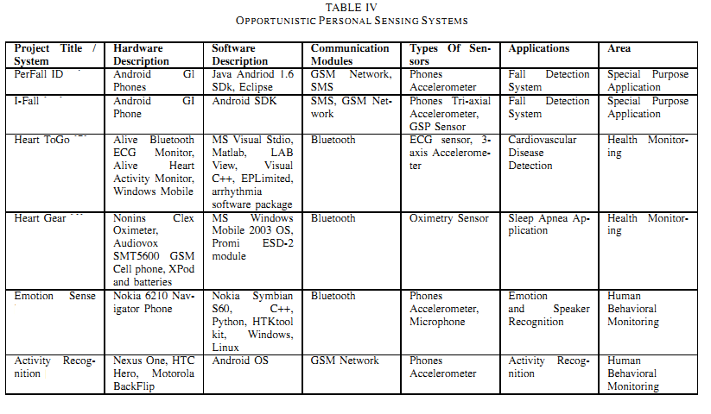
Opportunistic Personal Sensing Systems

Slide 10
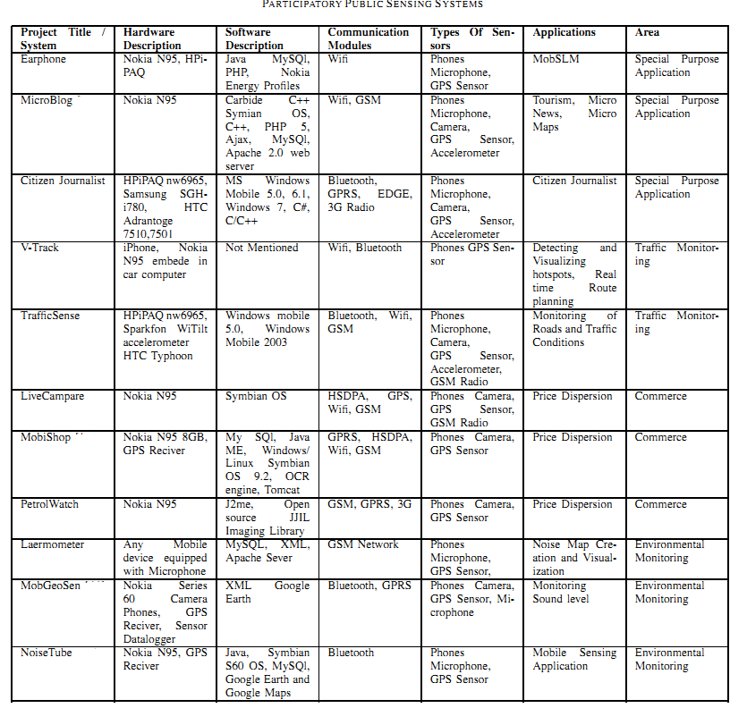
Participatory Public Sensing Systems

Slide 11
Applications
Transportation
Traffic conditions (MIT VTrack, Mobile Millennium Project)
Social Networking
Sensing Presence (Dartmouth’s CenceMe project)
Environmental Monitoring
Measuring pollution (UCLA’s PIER Project)
Health and Well Being
Promoting personal fitness (UbiFit Garden)

Slide 12
Applications of Mobile Sensing Systems

Slide 13
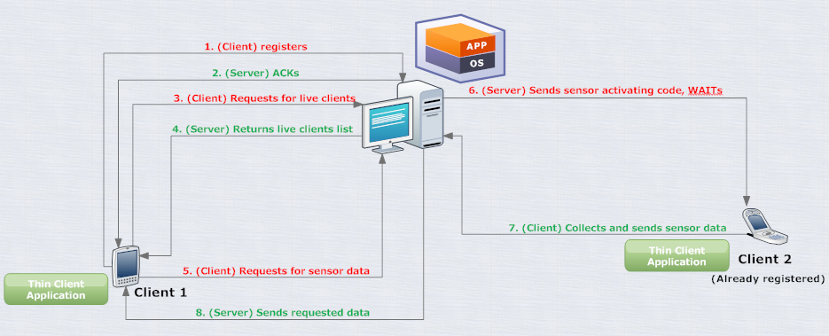
Application Architecture

Slide 14
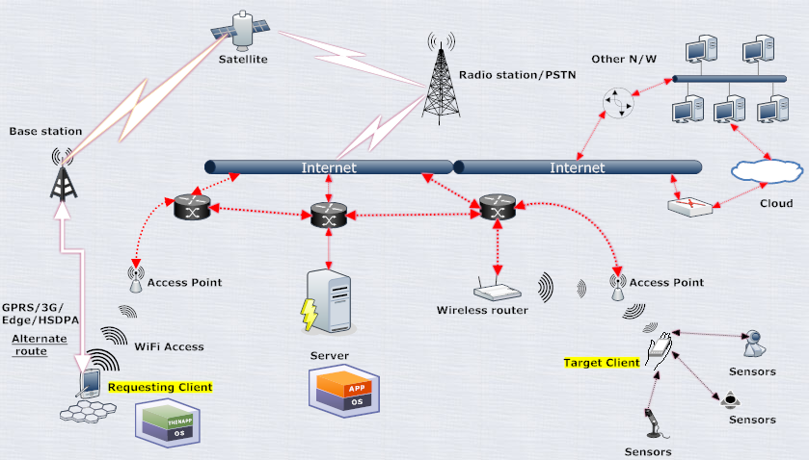
Infrastructure

Slide 15
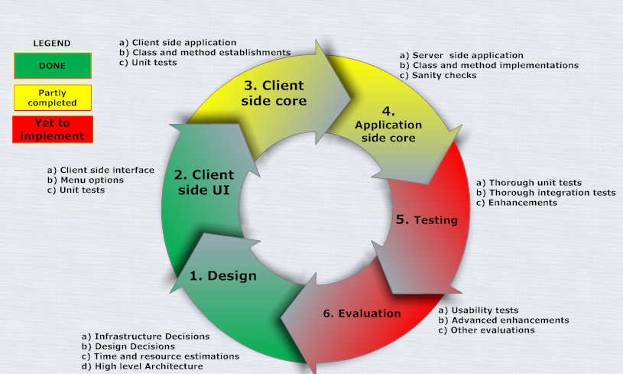
Milestones Achieved

Slide 16
Evaluations
Test Platform :
Consists of a laptop with WiFi connectivity as the server
Multiple Android phones ( two for the demo) with wifi connection
Test Cases
Establish the connectivity
Read sensor information
Multiple sensor acquisition

Slide 17
References
[1] I. Vasilescu, K. Kotay, D. Rus, M. Dunbabin, and P. Corke. Data collection, storage, and retrieval with an underwater sensor network.
[2] W. Kaiser, G. Pottie, M. Srivastava, G. Sukhatme, J. Villasenor, and D. Estrin. Networked Infomechanical Systems (NIMS) for Ambient Intelligence. Ambient Intelligence, 2004.
[3] Lane, N.D.; Miluzzo, E.; Hong Lu; Peebles, D.; Choudhury, T.; Campbell, A.T. “A survey of mobile phone sensing,” Communications Magazine, IEEE , Volume: 48 , Issue: 9 , pp. 140 – 150, 2010.
[4] CarTel: A Distributed Mobile Sensor Computing System Bret Hull, Vladimir Bychkovsky, Yang Zhang, Kevin Chen, Michel Goraczko, Allen Miu, Eugene Shih, Hari Balakrishnan and Samuel Madden MIT Computer Science and Artificial Intelligence Laboratory
[5] Pasztor, B.; Musolesi, M.; Mascolo, C. “Opportunistic Mobile Sensor Data Collection with SCAR,” Mobile Adhoc and Sensor Systems, 2007. MASS 2007. IEEE Internatonal Conference on , pp. 1 – 12, 2007.Hans-W. Gellersen1, Albrecht Schmidt and Michael Beigl “Multi-Sensor Context-Awareness in Mobile Devices and Smart Artefacts,” Department of Computing, Lancaster University
[6] A. Kapadia, D. Kotz, and N. Triandopoulos, “Opportunistic Sensing: Security Challenges for the New Paradigm,” Proc. 1st COMNETS, Bangalore, 2009.
[7] J. Healey and R, Picard, StartleCam: A Cybernetic Wearable Camera, Proc. of the International Symposium on Wearable Computing, Pittsburgh, PA, USA, October 1998

